Slide 1
Lecture 03: Time
Chris Walshaw
Computing & Mathematical Sciences
University of Greenwich

Slide 2
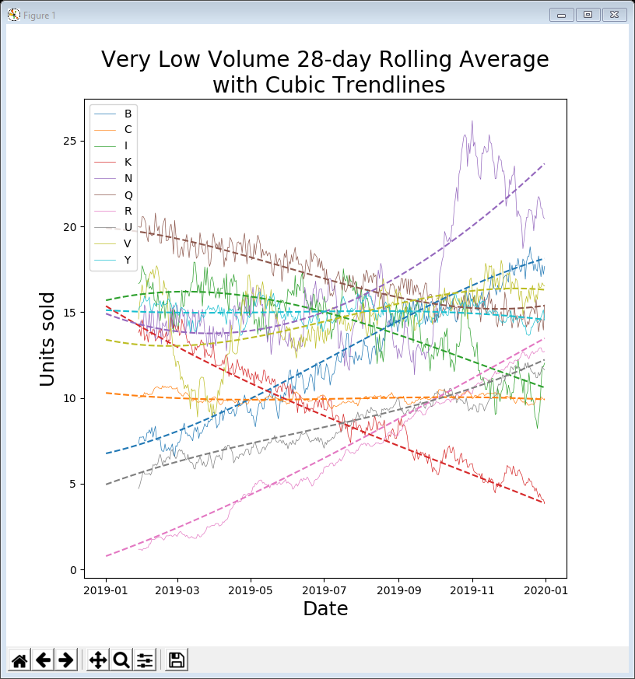
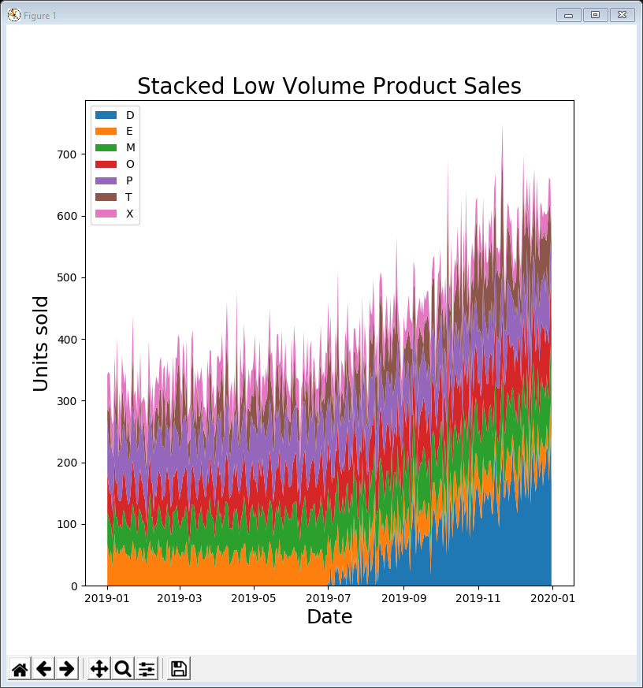
Motivation / Objectives
The company who supplied the data want to know about products that
don’t sell well or
aren’t very profitable or
cost too much to market or …
Last week we categorised products by annual total sales
high volume, medium volume, …
Today we take a closer look at trends over time using two further standard visualisations
line plots
area plots

Slide 3
Common features
Almost all of todays examples contain the same lines of code at the top
import the libraries & read in the data
As before the following lines prepare and show the plot
import matplotlib.pyplot as plt
import pandas as pd
data = pd.read_csv('https://tinyurl.com/ChrisCoDV/Products/DailySales.csv',
index_col=0)
pd.plotting.register_matplotlib_converters()
data.index = pd.to_datetime(data.index)
plt.figure(figsize=(8, 8))
... # this is where you draw the plot
plt.show()

Slide 4
Handling date / time
Did you notice the 2 extra lines (in bold)
also that we are not using numpy (for most examples)
Strictly speaking only the last line is necessary
it converts the data index to dates & times so they are handled correctly
The other line just prevents a warning message
import matplotlib.pyplot as plt
import pandas as pd
data = pd.read_csv('../Data/Products/DailySales.csv',
index_col=0)
pd.plotting.register_matplotlib_converters()
data.index = pd.to_datetime(data.index)

Slide 5
The data
As we saw already the daily sales data contains
25 columns, one for each product type
365 rows, one for each day of the year
check this by getting a summary with .head()
This kind of data is known as time-series data
a set of regularly timed measurements (here, one every day)
very common in sales, financial data (e.g. share prices), environmental data (e.g. temperatures), resource management (e.g. number of patients), …
We are going to explore the daily sales for each product over the year
to get a sense of what happens over time
print(data.head())

Slide 6
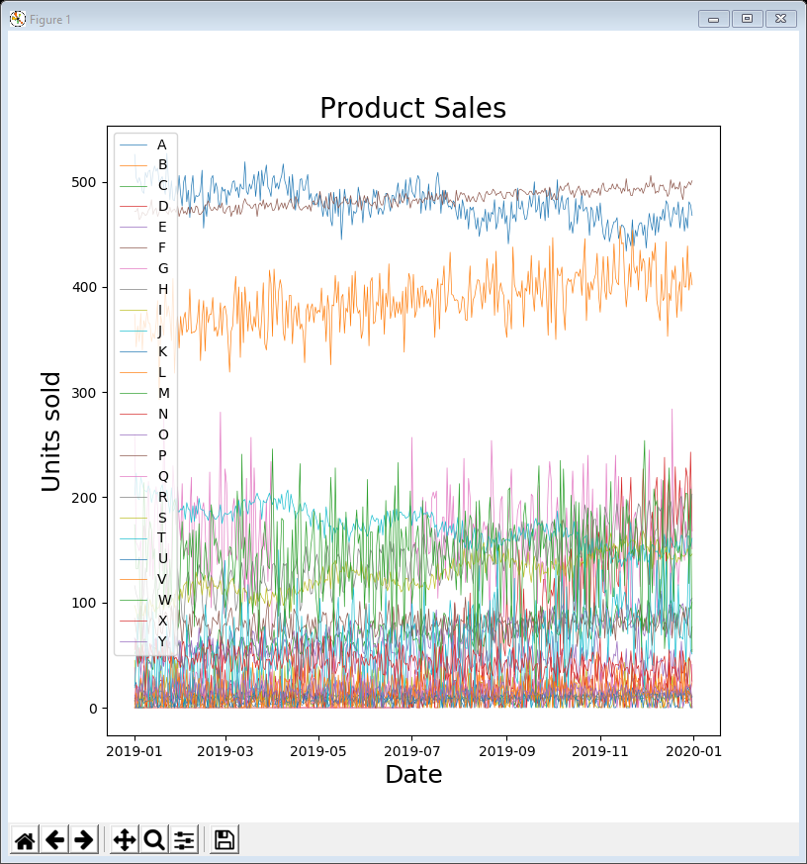
01LinePlot all.py
The following code creates the plot on the right
The single line in bold actually creates the line plot
As before, the other lines prepare the figure, add labels and title and finally show it
Also we can add a legend, showing which line is which
like we did for the pie chart
plt.figure(figsize=(8, 8))
plt.plot(data, linewidth=0.5)
plt.xlabel('Date', fontsize=18)
plt.ylabel('Units sold', fontsize=18)
plt.title('Product Sales', fontsize=20)
plt.legend(data.columns, loc=2)
plt.show()

Slide 7
Segmenting the data
This plot contains far too much information to understand so, as before, we segment the data
Last week we visually identified products A, F & L as the high volume ones
could also work this out by sorting the data and printing out the .sum() of the columns
or even just the sum of the first few columns
Initially let’s explore these high volume columns
data = data.reindex(data.sum()
.sort_values(ascending=False).index, axis=1)
print(data.sum())
print(data.sum().head())

Slide 8
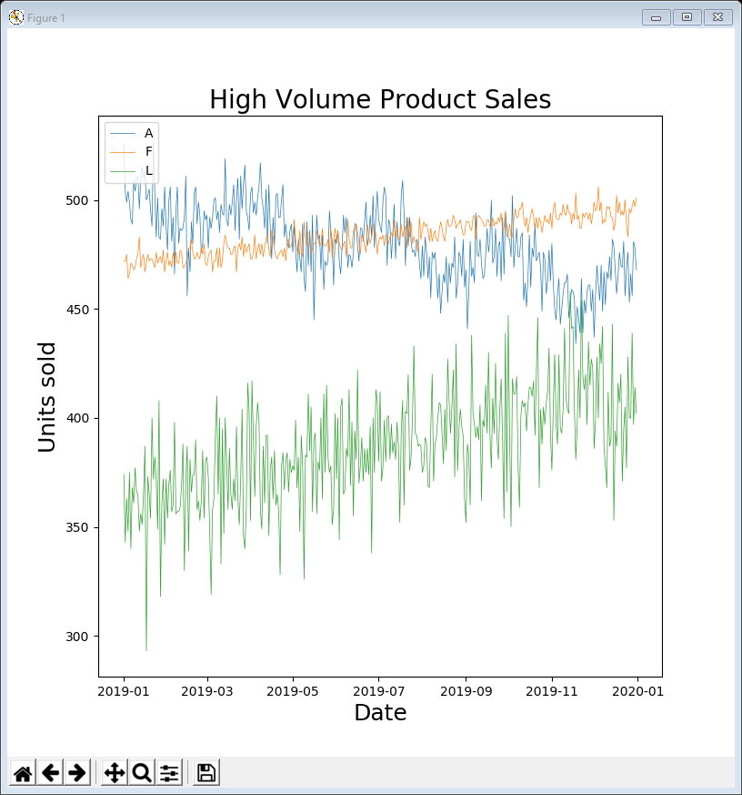
02LinePlot high volume.py
Just select some of the columns and replace data with data[selected]
The code in bold shows changes from example 01
So looks like A & F are the really big sellers and L only sells about half as much as either … right?
WRONG!!! … the y-axis starts at around 280
selected = ['A', 'F', 'L']
print(data[selected].head())
plt.figure(figsize=(8, 8))
plt.plot(data[selected], linewidth=0.5)
plt.xlabel('Date', fontsize=18)
plt.ylabel('Units sold', fontsize=18)
plt.title('High Volume Product Sales',
fontsize=20)
plt.legend(data[selected], loc=2)
plt.show()

Slide 9
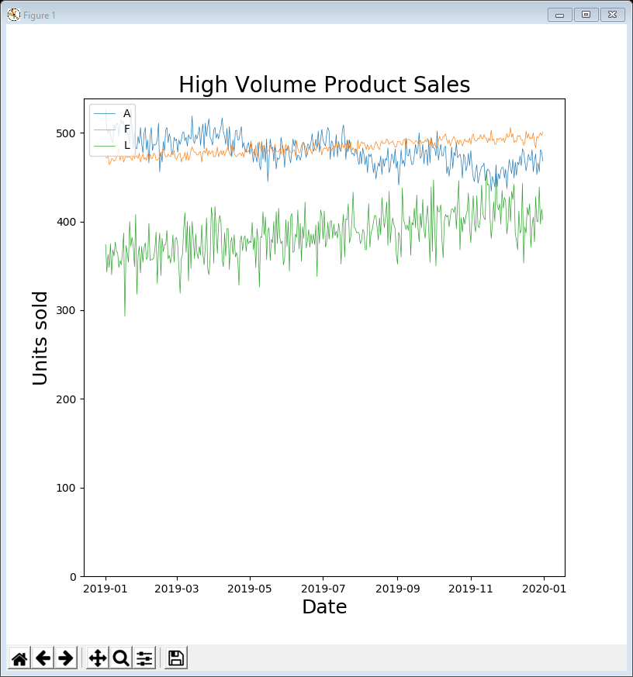
03LinePlot high volume axis zeroed.py
Matplotlib decides on the limits of the y-axis so that the lines fit nicely in the plot area …
… but this can be very misleading
so it’s a trick employed by sales-people and politicians the world over (sometimes)
In the next example we correct this by setting the minimum y limit to 0
That’s better! L is not as high volume as the other two but still relatively high
plt.figure(figsize=(8, 8))
plt.plot(data[selected], linewidth=0.5)
plt.ylim(ymin=0)
plt.xlabel('Date', fontsize=18)
plt.ylabel('Units sold', fontsize=18)
plt.title('High Volume Product Sales',
fontsize=20)
plt.legend(data[selected], loc=2)
plt.show()

Slide 10
Averaging & trends
We can see that
A is declining a little over the year and seems to have some (possibly regular) peaks and troughs
F is growing slowly but is much more consistent
L is growing quite fast but is not very consistent (has a lot of noise)
We will explore the peaks / troughs and consistency in Topic 05 Distribution
Here we are interested in reducing some of the noise and examining the trends
We can eliminate some of the noise using averages
for example plotting a weekly average of sales rather than every single day

Slide 11
Resampling data
Pandas gives us an easy way to get a weekly average
there are 365 ÷ 7 = 52.14 weeks a year which is rounded up
so averaged_data is a new dataframe with 53 rows
Other possible sample rates that we could use for our daily sales data include
‘M’ monthly (i.e. end of every month)
‘SM’ semi-monthly (i.e. 15th and end of every month)
‘Q’ quarterly (i.e. end of every 3 months)
If you have shorter time intervals there are also ways to sample every hour, minute, second and multiples of these (e.g. every 30 seconds)
sample_rate = 'W' # weekly
averaged_data = data.resample(sample_rate).mean()

Slide 12
Overlaying line plots
We could just plot averaged_data but that obscures the fact that some of the time-series have more noise
Instead we draw the original lines and then overlay the averaged data using two calls to plt.plot()
Without modification this results in the averaged lines having different colours to the originals
an easy fix is to reset the matplotlib colours between the two calls

Slide 13
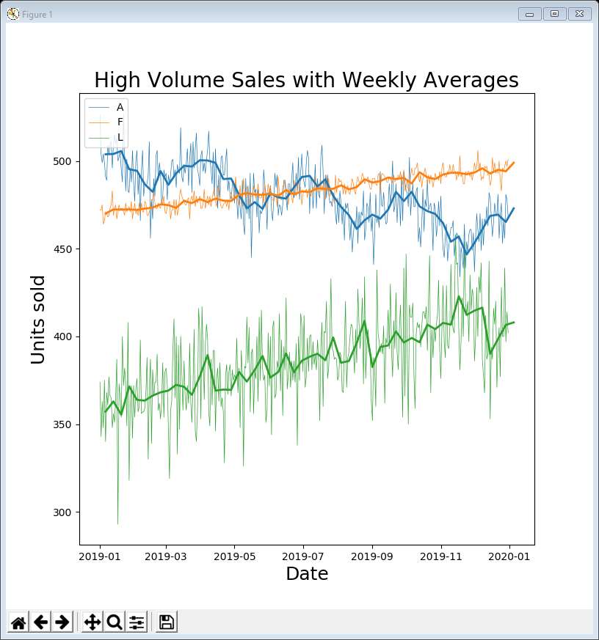
04LinePlot high volume averaged.py
Here’s the whole program (apart from reading the data in)
.gca() gets the current axes (i.e. the current chart)
.set_prop_cycle(None) resets all the properties for this chart, including colours, linestyles, etc.
we use different line widths to distinguish the averages from the original
sample_rate = 'W' # weekly
averaged_data = data.resample(sample_rate).mean()
selected = ['A', 'F', 'L']
plt.figure(figsize=(8, 8))
plt.plot(data[selected], linewidth=0.5)
plt.gca().set_prop_cycle(None)
plt.plot(averaged_data[selected], linewidth=2)
plt.xlabel('Date', fontsize=18)
plt.ylabel('Units sold', fontsize=18)
plt.title('High Volume Sales with Weekly Averages',
fontsize=20)
plt.legend(data[selected], loc=2)
plt.show()

Slide 14
Rolling averages
Sometimes the average can obscure the noise a bit too much
An alternative is the rolling average
also known as moving average, running average, rolling mean, …
The idea is that for every data point we compute an average of the last n data points
where n could be 7 (i.e. an average the last week), 14 (the last fortnight), etc.
For example, if n = 14
for 14th January we compute an average from 1st to 14th inclusive
for 15th January we compute an average from 2nd to 15th inclusive
for 16th January we compute an average from 3rd to 16th inclusive …
So for our data, if we choose n = 7 we compute a total of 359 averages
since we can’t compute averages for the 1st, 2nd, 3rd, 4th, 5th & 6th January (so 365 – 6 in total)
However, there are variations on the technique, for example
filling in the initial values by averaging shorter periods for those data points
weighting the rolling average so that more recent data points have greater impact

Slide 15
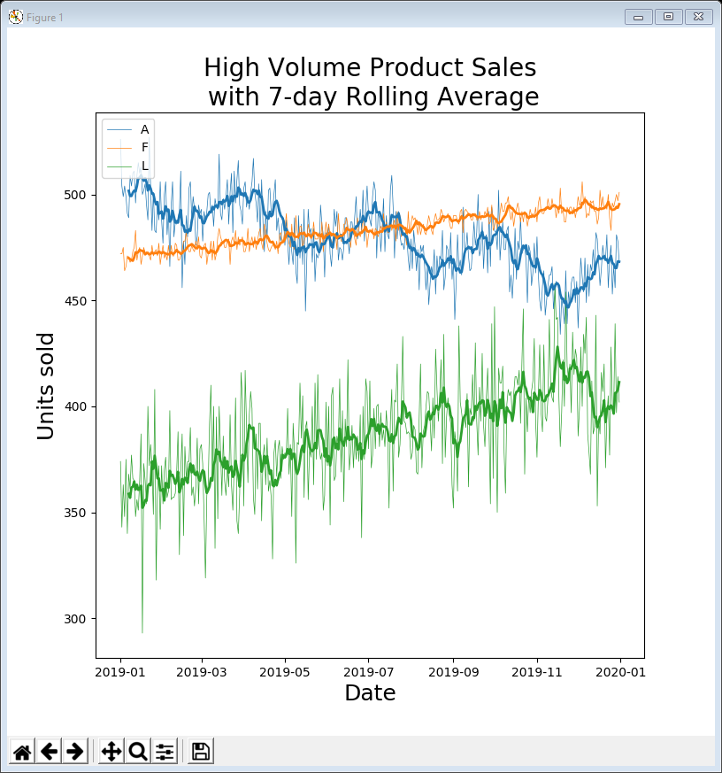
05LinePlot high volume rolling averaged.py
Pandas will calculate the rolling average for you
Here’s the program
the 7-day rolling average line is a bit less smooth than the weekly average in the previous example
period = 7
rolling_average = data.rolling(window=period).mean()
selected = ['A', 'F', 'L']
plt.figure(figsize=(8, 8))
plt.plot(data[selected], linewidth=0.5)
plt.gca().set_prop_cycle(None)
plt.plot(rolling_average[selected], linewidth=2)
plt.xlabel('Date', fontsize=18)
plt.ylabel('Units sold', fontsize=18)
plt.title('High Volume Product Sales\n
with 7-day Rolling Average', fontsize=20)
plt.legend(data[selected], loc=2)
plt.show()

Slide 16
Trendlines
Another way of making sense of the data is to calculate a trendline for each time-series
a line showing whether the general trend of the time-series is increasing over time or decreasing or flat
The formal name for this is linear regression
linear because we compute a straight line through the data points
There are also more advanced techniques, e.g.
non-linear regression – i.e. compute a curved trendline (because most trends don’t actually go in a straight line!)
multivariate regression – i.e. compute a trendline for a combination of time-series (beyond the scope of this module)

Slide 17
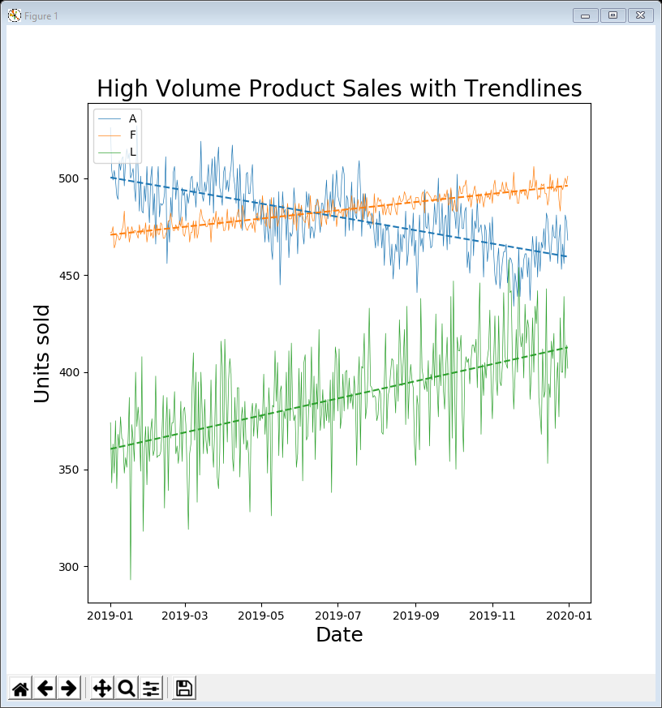
06LinePlot high volume trendline.py
Pandas doesn’t have a method to calculate trendlines
instead we use NumPy to do this
Here’s the program
we will look at the trendline code on the following slide
notice we can create dashed trendlines by setting the linestyle parameter
selected = ['A', 'F', 'L']
plt.figure(figsize=(8, 8))
plt.plot(data[selected], linewidth=0.5)
plt.gca().set_prop_cycle(None)
for name in selected:
x = np.arange(len(data[name]))
z = np.polyfit(x, data[name], 1)
trend = np.poly1d(z)
plt.plot(data.index, trend(x), linestyle='--')
plt.xlabel('Date', fontsize=18)
plt.ylabel('Units sold', fontsize=18)
plt.title('High Volume Product Sales'
+ ' with Trendlines', fontsize=20)
plt.legend(selected, loc=2)
plt.show()

Slide 18
Trendline code
To create a trendline for each selected time-series
Loop over the selected columns
NumPy fits a polynomial curve to the time-series using polyfit()
the 1 indicates that it is linear (a straight line is a polynomial of degree 1)
We “save” the trendline NumPy has calculated in a function called trend
Plot the trendline against the dates (i.e. the index of the dataframe)
for name in selected:
x = np.arange(len(data[name]))
z = np.polyfit(x, data[name], 1)
trend = np.poly1d(z)
plt.plot(data.index, trend(x), linestyle='--')

Slide 19
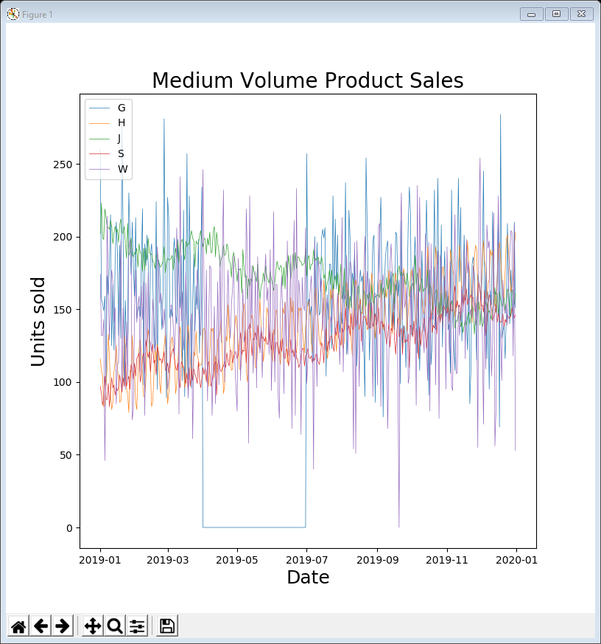
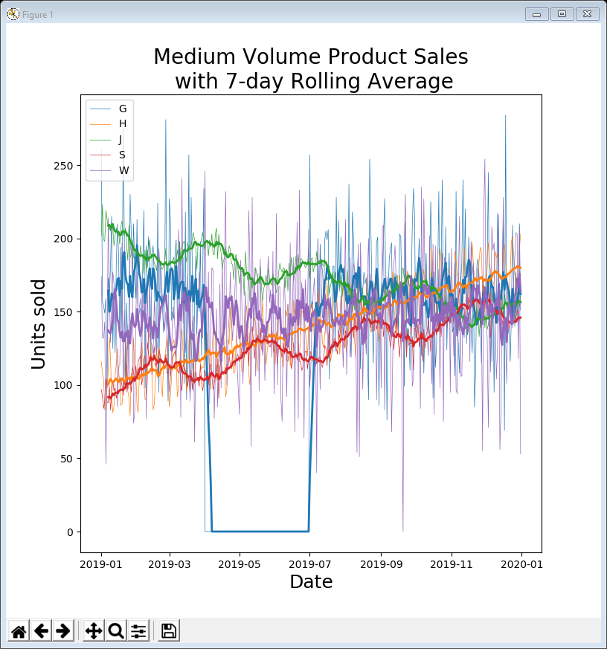
Examples 07 & 08
We can now apply these techniques to other segments of the data, e.g. for medium volume the only change is
Examples 07 & 08 explore the medium volume products and show how the rolling averages really help to show what is going on
selected = ['G', 'H', 'J', 'S', 'W']
something has happened to product G between April & June (out of stock, data error, …?)

Slide 20
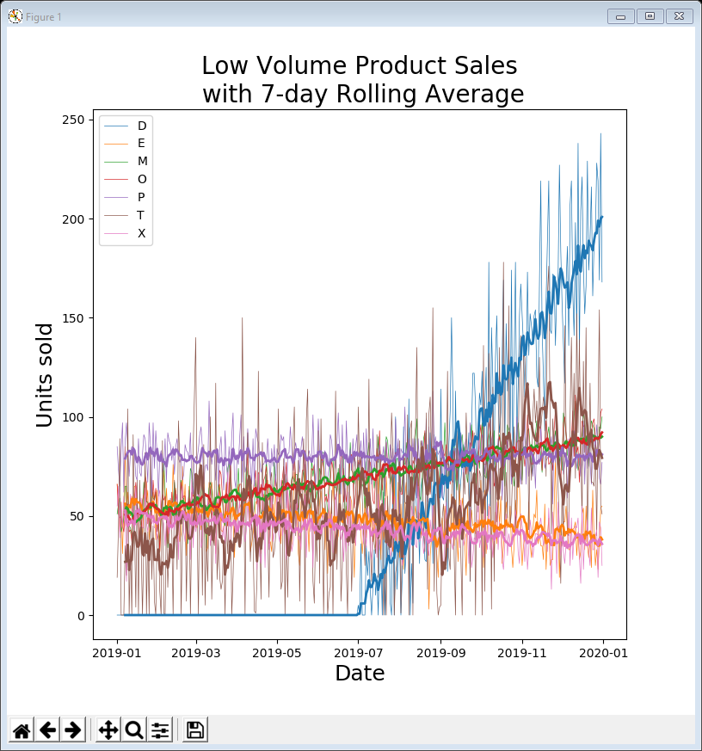
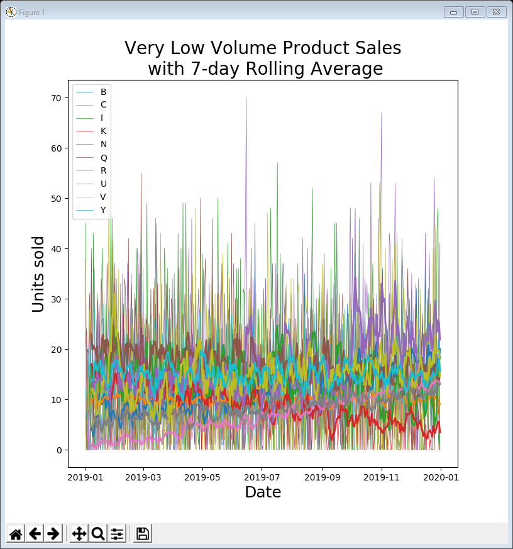
Examples 09 & 10
Examples 09 & 10 show the time-series plots with rolling averages for low & very low volume products
selected = ['D', 'E', 'M', 'O', 'P', 'T', 'X']
selected = ['B', 'C', 'I', 'K', 'N', 'Q', 'R', 'U', 'V', 'Y']
product D is an anomaly – unavailable initially but then with rapid growth in sales … maybe a new product introduced mid-year
still too much noise to really make sense of this data

Slide 21
Further explorations
The very low volume plot (example 10) still has too much noise to make sense of
Can reduce the noise in a number of ways
only show average or rolling average line plots
extend the averaging period (e.g. monthly averages / 28-day rolling averages)
For data with lots of noise (a.k.a. a high noise-to-signal ratio) can fit a higher order polynomial as a trendline in polyfit()
e.g. 2 for a quadratic curve, 3 for a cubic curve, or 10 for a polynomial of degree 10
but the higher the number the more closely it fits the data (and so is less valuable as trend)
also for higher numbers, the calculations become more and more inaccurate
Or can segment the data further

Slide 22
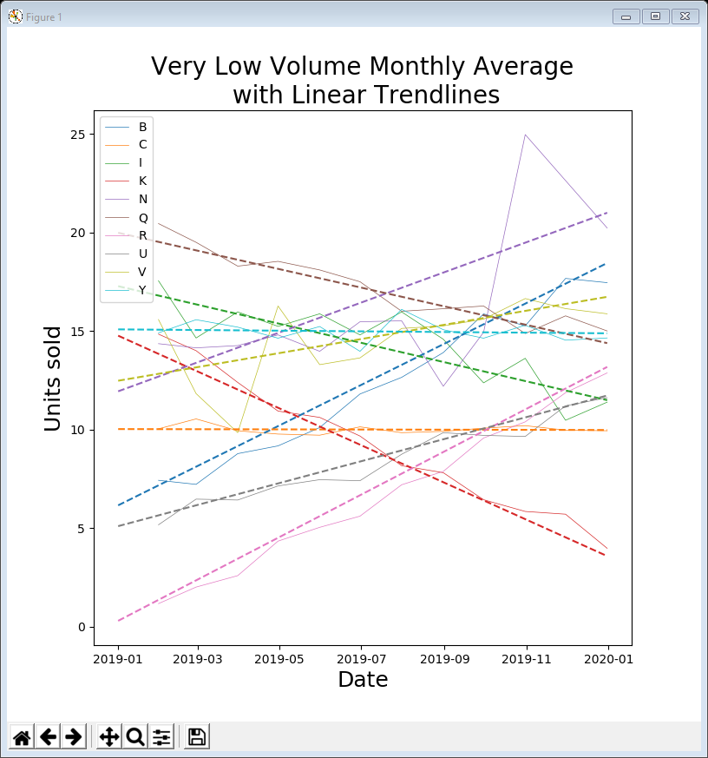
Examples 11 & 12
Examples 11 & 12 show a couple of examples for very low volume data
example 11 shows monthly average data with linear trendlines
example 12 shows 28-day rolling average data with trendlines of degree 3 (cubic equations)

Slide 23
Area plots
We now have a much clearer picture of how individual products are selling
But we still don’t know how the company is doing as whole, in terms of sales
An easy way to do this is with a stacked area plot
Like a line plot but
the area under each line is filled in
the areas are stacked on top of each other

Slide 24
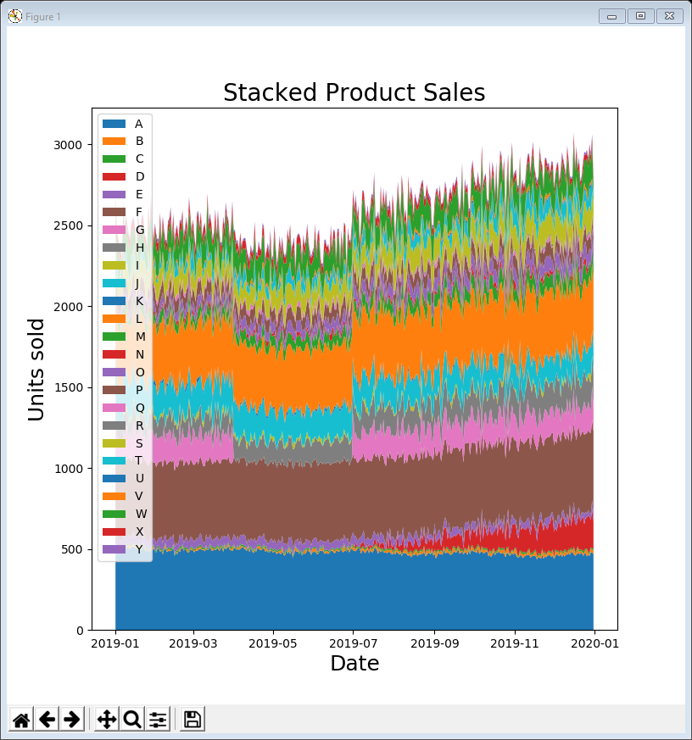
13AreaPlot all.py
To create a stacked area plot, use stackplot() and transpose() the data so that the values can be accumulated
Here’s the program (apart from reading in the data) and resulting plot
Clearly shows
the company sales are growing overall
the sudden disappearance of product G in the second quarter of the year
the growth of product D in the second half of the year
plt.figure(figsize=(8, 8))
plt.stackplot(data.index, data.transpose())
plt.xlabel('Date', fontsize=18)
plt.ylabel('Units sold', fontsize=18)
plt.title('Stacked Product Sales',
fontsize=20)
plt.legend(data.columns, loc=2)
plt.show()

Slide 25
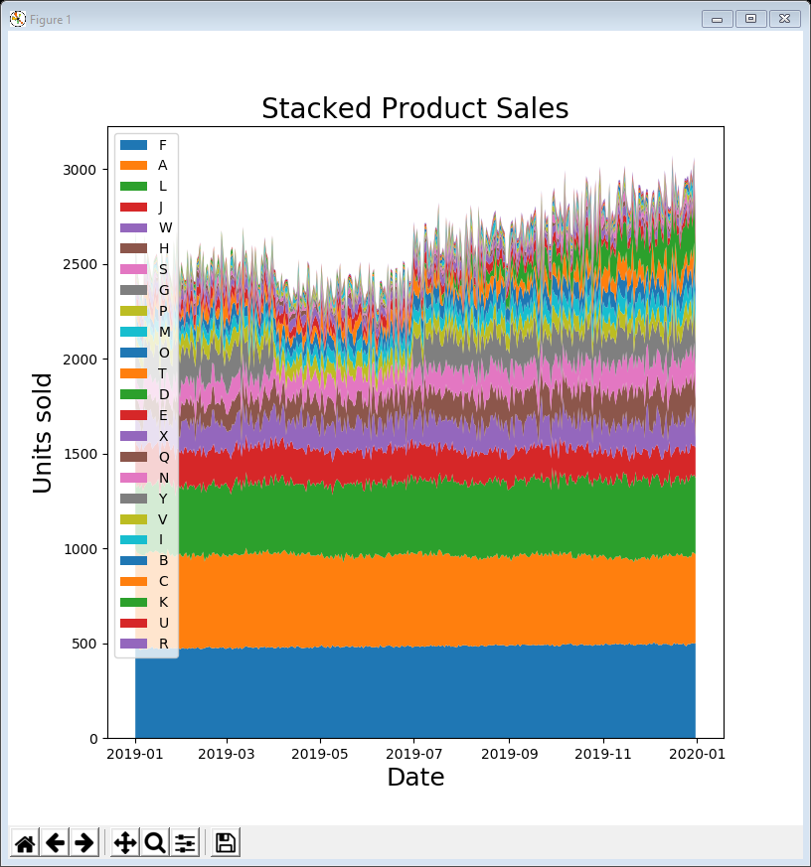
14AreaPlot all sorted.py
It’s generally considered good practice to sort the data before creating a stacked area plot so that the higher volume data is at the bottom
Here’s the program and resulting plot
Shows relative proportions of high and medium volume products better …
… but doesn’t show the growth of product D so clearly
data = data.reindex(data.sum()
.sort_values(ascending=False).index, axis=1)
plt.figure(figsize=(8, 8))
plt.stackplot(data.index, data.transpose())
plt.xlabel('Date', fontsize=18)
plt.ylabel('Units sold', fontsize=18)
plt.title('Stacked Product Sales', fontsize=20)
plt.legend(data.columns, loc=2)
plt.show()

Slide 26
15AreaPlot low volume sorted.py
As always, if you want more detail, segment the data
example 15 shows just the low volume products (sorted as before)
Here’s the program and resulting plot
Since product D is on the bottom it must have the highest volume sales in total
despite not being available for half the year
data = data.reindex(data.sum()
.sort_values(ascending=False).index, axis=1)
selected = ['D', 'E', 'M', 'O', 'P', 'T', 'X']
plt.figure(figsize=(8, 8))
plt.stackplot(data.index, data[selected].transpose())
plt.xlabel('Date', fontsize=18)
plt.ylabel('Units sold', fontsize=18)
plt.title('Stacked Low Volume Product Sales', fontsize=20)
plt.legend(selected, loc=2)
plt.show()

Slide 27
Line / area plot guidelines
Many good practices are already done by default in matplotlib (although you can override them)
don’t show too many time-series in the same chart (some of the examples have too many)
start the y-axis at 0 (if possible / appropriate)

Slide 28
Data conclusions
Reminder - we are not making business recommendations
let the business analyst decide what to do
However …
can see some products have considerable variation and / or peaks & troughs (see Topic 05)
fairly easy to identify some trends in sales
easy to spot some anomalies where a product (or possibly the data) was not available (i.e. products D & G)

Slide 29
Lecture summary
Looked at visualising relative proportions using
line plots
area plots (or charts)
Can significantly enhance data exploration with
averages
rolling averages
trendlines
and again, segmentation (high / medium / low / …)

